Slide 1
Data Organisation
HDX Thread 5:
ICT Awareness and Competency in
Data Governance
Foundational Structures of Asset Governance
Ben Koo,
Tim Bansemer,
Jared Cordon
May 25, 2021
Notes:
Key Value Pairs
3 infrastructure
Git
Wiki
Service management

Slide 2
Introduction
Review of first presentation
Notes:
(notes)
Make sure that they understand that working with the three challenge projects is to show them that all these principles exist in these organizations. We change the way they view the world so they can solve problems in their own environments
Page services files
Dev Sec Ops
Tools
Work flow

Slide 3
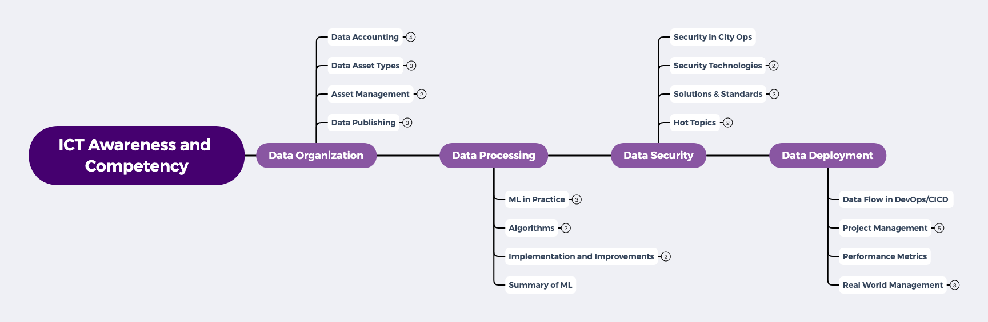
Thread 5 Content Roadmap
In Data Governance
Notes:
Becoming a data governor MEANS being able to be empowered to participate in the exponential data economy and to stay relevant WHILE being able to meaningfully contribute to society and current risks and challenges we face collectively.

Slide 4
Data Organization is about...
Structuring Data to maximize Processing Automation
Must know: Key-Value Pairs/Data Dictionary, Machine Learning
Adopting Security Standards for Streamlined Data Verification
Must know: Technology Standards, Proposal Workflows
Accelerating lifecycles for Product/Service Deployment
Must know: Enabling Technologies for DevOps, CI/CD
Notes:
(notes)
In the process of data model/information approximation, UDA maybe judged by three conditions: Soundness, Termination, and “Relative” Precision.
All three properties can be teased out of manipulating Lattices/Partially Ordered Sets (POs), which are constructed out of key-value pairs.

Slide 5
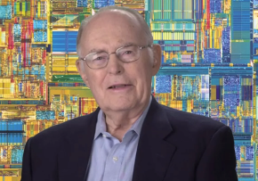
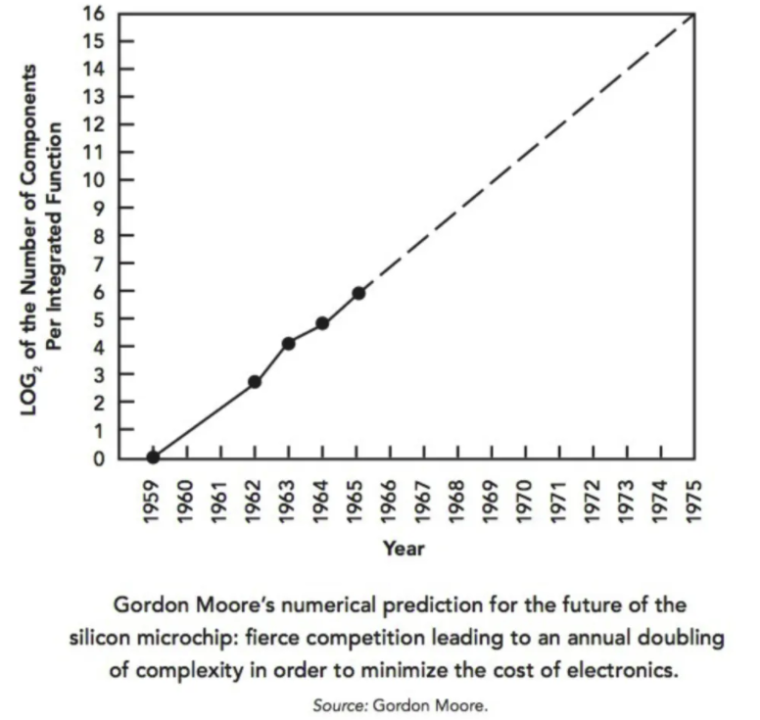

The Secret of Information Asymmetry
Before Moore, Data was dimensionless...
Space
What these top billionaires have in common that everyone else does not know.
by Vivek Sakpal May 19, 2018
Time
Moore provided the measurable strategy for executives that connected from socio-economic systems to quantum physics, and data sciences...
Moore’s Law is a sound Roadmap that associates physical dimensions with Data.
Notes:
How Startups from silicon valley disrupted the F500 with exponential growth
WHY did they succeed: Because they rely on a new paradigm which is moores law

Slide 6

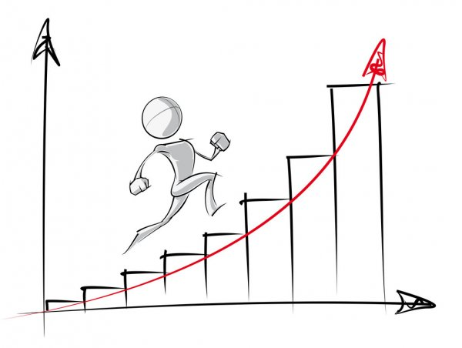
Thrive with Moore’s Law by acquiring the keys...
Expanding and managing your awareness of foundational ICT Vocabulary.
You will use a sound glossary as a Roadmap to navigate the knowledge landscape of our data-intensive Spacetime.
Notes:
Organise data to enable Security, Processing, Deployment
(notes) tensor flow logo??
Companies are using cloud services to gain access to tools that will hopefully improve their efficiency and ability to profit from Data; however, most companies do not have proper Namespace Management (NsM) so therefore the current methods of managing Data Assets, are complex, costly, and most importantly causing data to be a liability and not an asset.

Slide 7



The Basic Vocabulary on Data Content
Soundness
Precision
Termination
This is the zero-level glossary.
Notes:
(notes) add hyperlinks with definitions
Soundness: A Sound statement is a true statement whose composed sub-statements all accountably true, and the overall constructed statement also can be assessed to be true.
The degree of a statement to be sound is its Soundness assessment.
Precision (The result has a outer boundary)
Termination (It will come to completion)

Slide 8
The rule for Universal Data Abstraction
“Everything should be made as simple as possible,
but not simpler.”
Albert Einstein
Data Governance:
A sound data practice that attains
precise,
yet terminable
Data Asset Management.

Slide 9
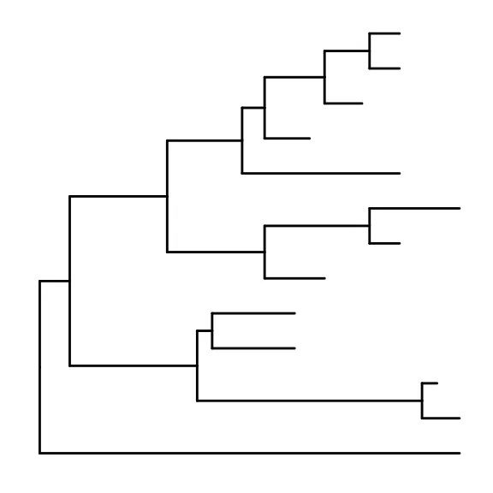

Data : Relations in Spacetime
Time
Data 2
Data 3
Data 1
Data: a discrete piece of evidence that proposes or breaks information symmetry based on previously available data.
Scott’s first axiom:
A data type is a partially ordered set (Poset).
Excerpt from: Outline of a Mathematical Theory of Computation
Space
Data 0
(Encoding Standards: all data can be encoded as Poset.)

Slide 10

The Soundness of Causal Data in Physical Space
Future
Present
Moment
Image Source: Wikipedia on light cone
Past
Private Space
Public Space
Public
Space
Spaces of Influences

Slide 11








A Roadmap for navigating Data in Spacetime
Future
Deployment
Present
Processing
Past
Public
Private
Public
Space of Data Privacy

Slide 12
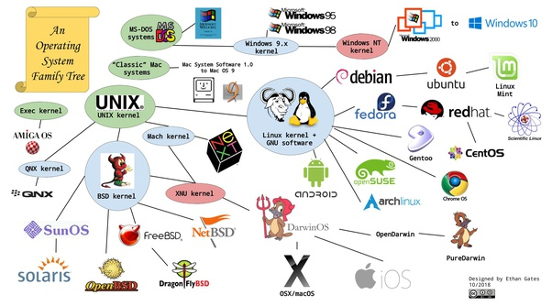
Please key-in all Operating Systems you have used?
Go to www.menti.com and use code: 4553 4696

Slide 13
Processing Data
Operating System: a generalized platform for data processing
Notes:
(notes)
Make sure that they understand that working with the three challenge projects is to show them that all these principles exist in these organizations. We change the way they view the world so they can solve problems in their own environments
Page services files
Dev Sec Ops
Tools
Work flow

Slide 14
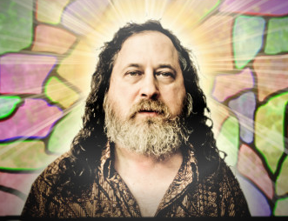
The Contract on Data Governance
Open Source
Right to use published source code
Right to study published source code
Free Software
Freedom to modify published source code
Freedom to distribute modified software
Richard Stallman
Founder of Free Software Foundation
Creator of GNU/Linux
GNU is the acronym of GNU is Not Unix

Slide 15
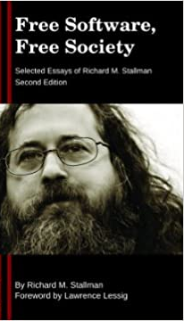

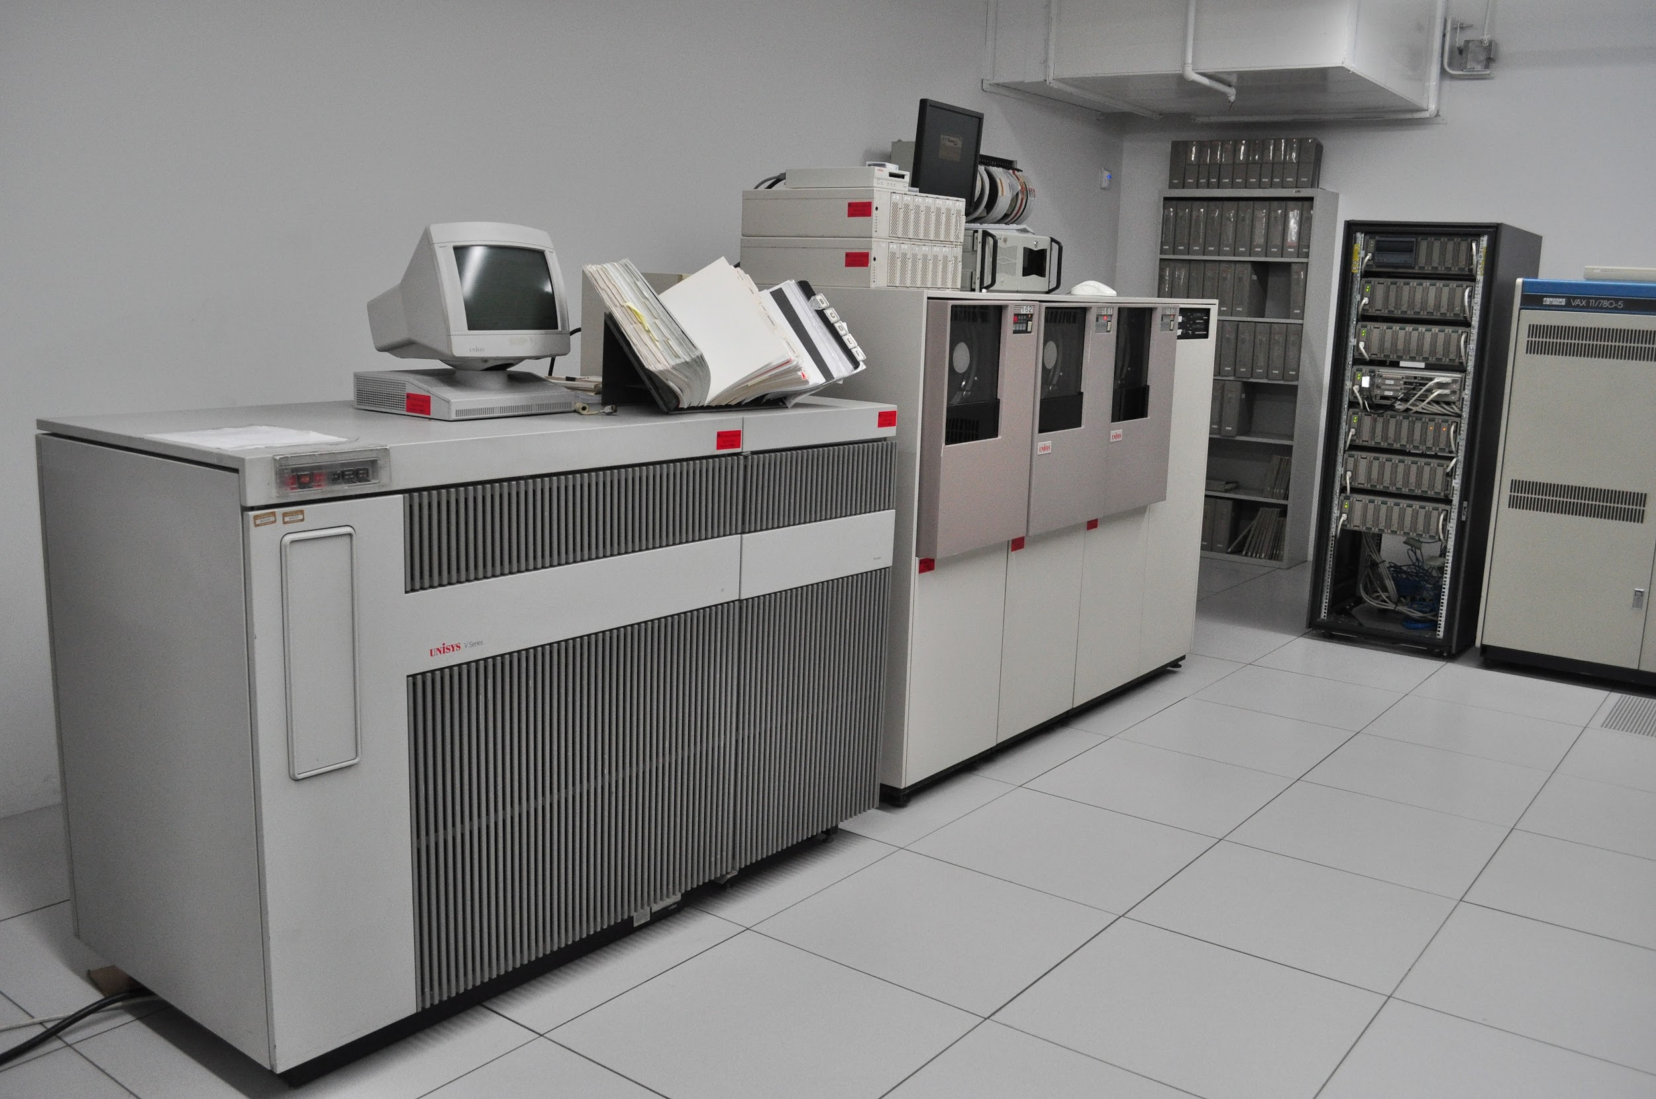
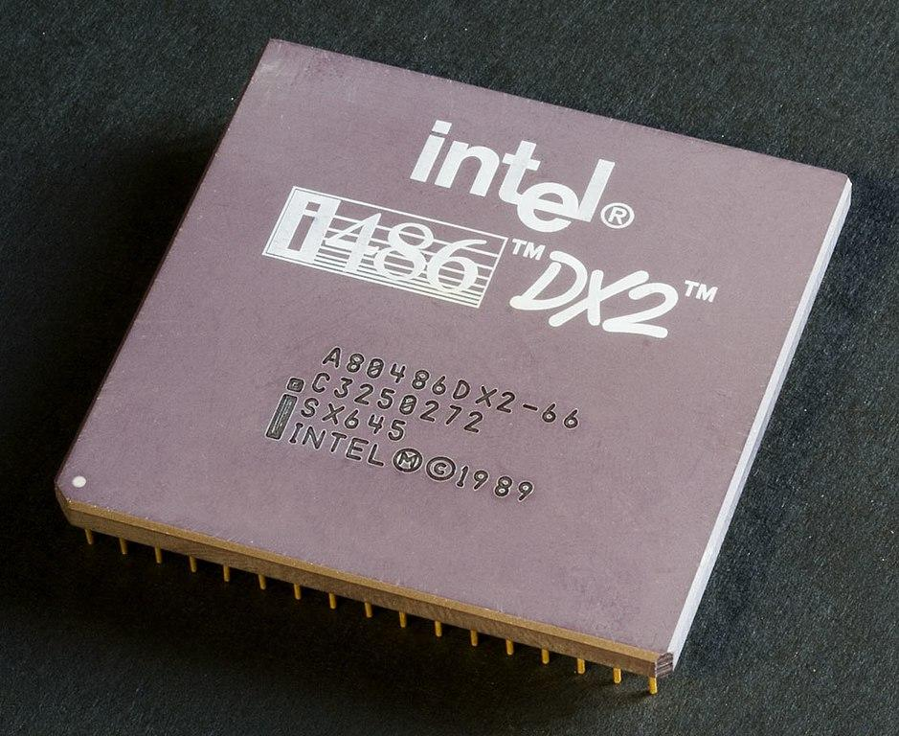
Free Software Operating System
Notes:
(notes) graphics???

Slide 16




Browsers are the new operating systems
open-source
closed-source
Microsoft Edge
Chromium
open-source
closed-source
Brave
Google Chrome
Notes:
Wasm adds new capabilities for browsers as operating systems

Slide 17
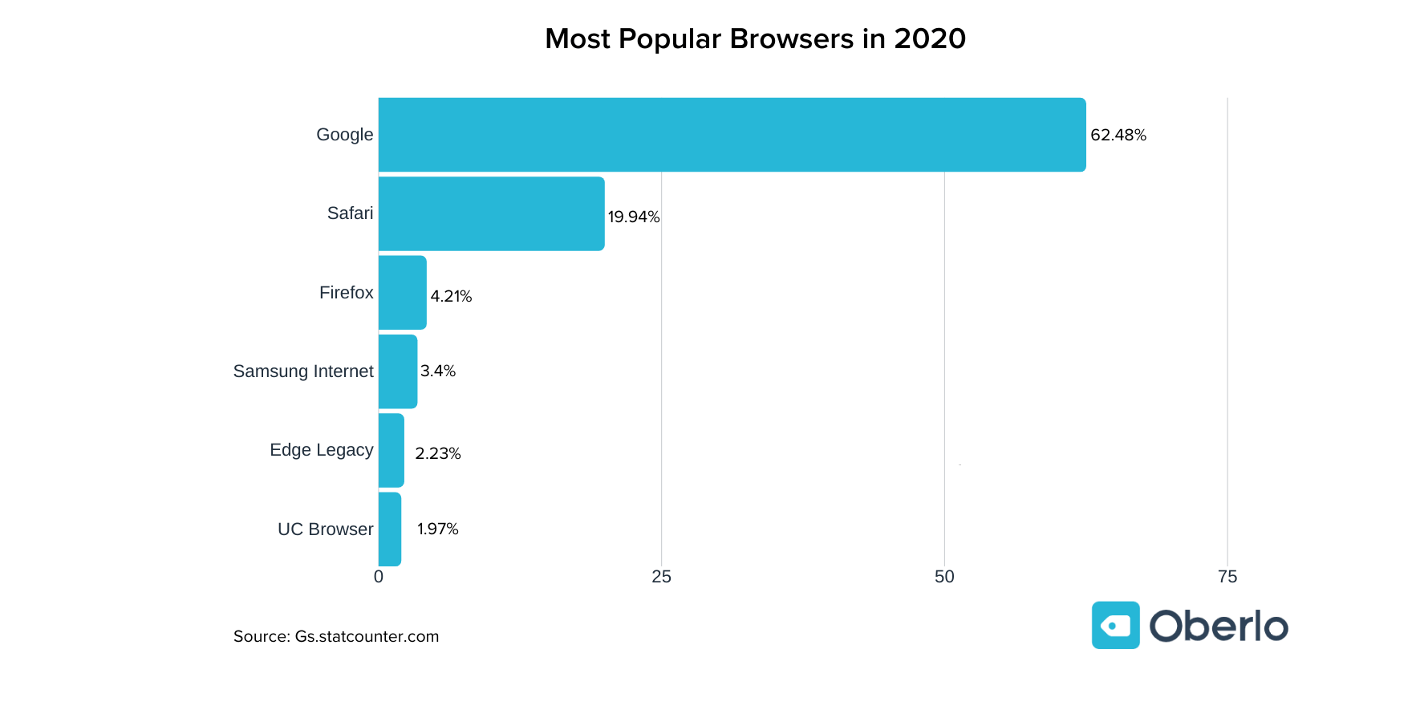





Slide 18





Visual/Iconic Vocabulary

Slide 19
Open Standards - Foundation of the Internet
Domain Name System and IP address management
ICANN Internet Corporation for Assigned Names and Numbers, US
Governance Institutions of Internet protocol standards
Internet Engineering Task Force (IETF), US
IEEE - Institute of Electrical and Electronics Engineers, US
W3C - World Wide Web Consortium (W3C), US
NIST (Encryption) -National Institute of Standards and Technology, US
Notes:
Tim comment: I believe we should point out that protocol abstractions / standards is essential in data organization. This is one of the biggest legacies ‘open standards and free software build up on it’.

Slide 20
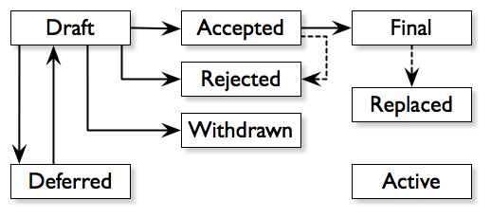

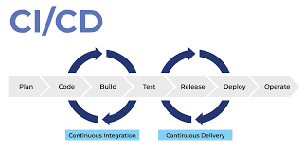

Technology Improvement Workflow
Bitcoin
Ethereum
BIP0039 Mnemonic
BIP0032 HDW
Pull Request
EIP
BIP
Image Source: Testbone.com on CI/CD

Slide 21


Moving Toward Data-Centric Operating Systems
Incomplete example list
Ethereum Foundation
Web 3 Foundation

Slide 22


The Universal Component for Data Organisation
Key
Hyperlink
Value
why directed link is a form of universal data abstraction

Slide 23
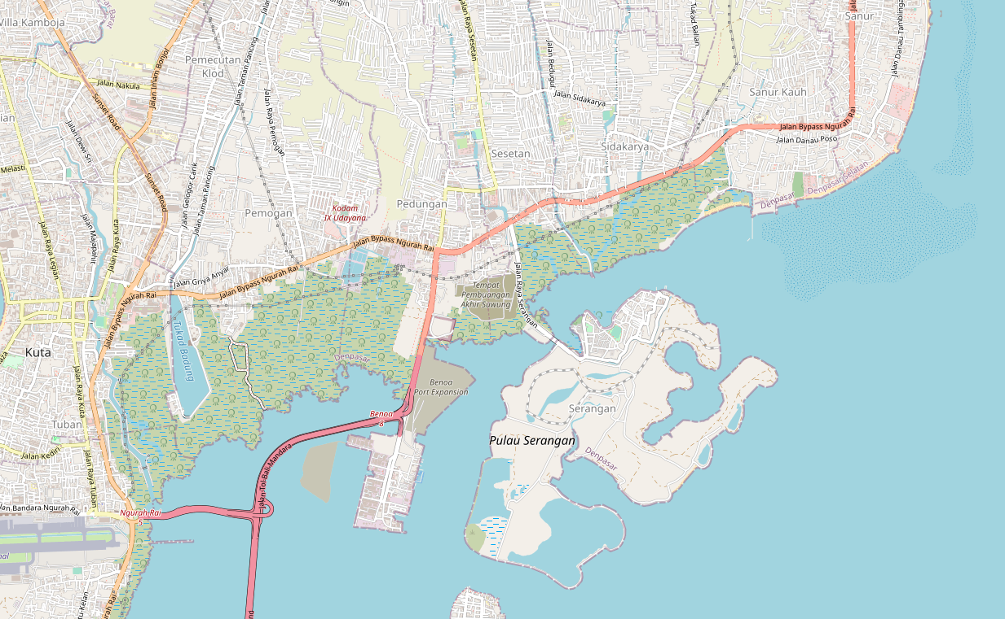
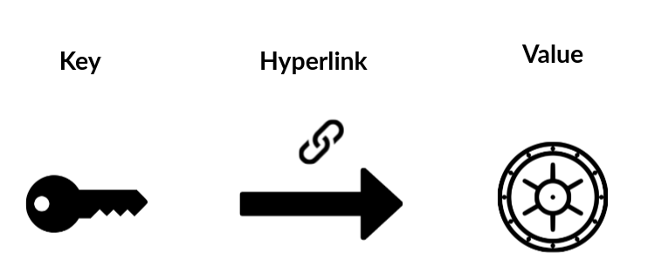
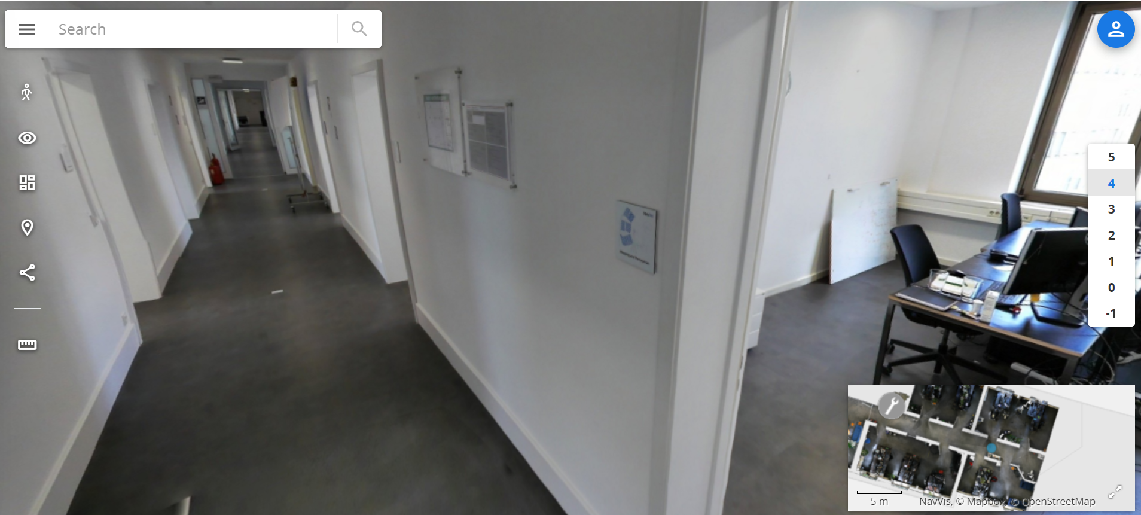
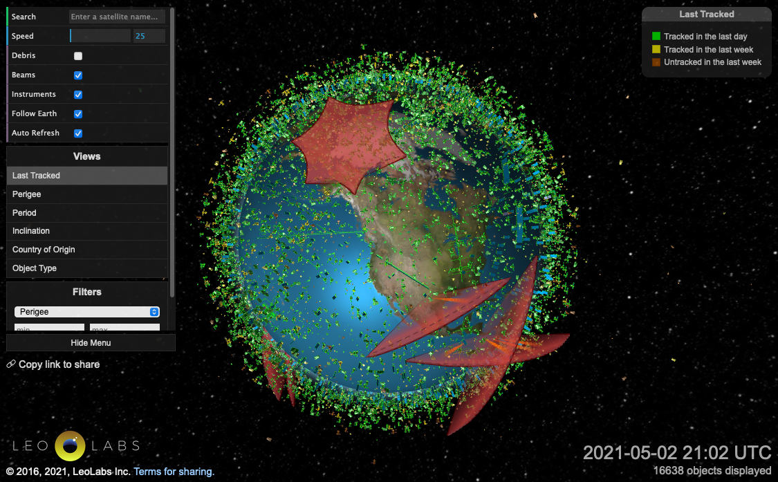
Data Organized as Multi-Dimensional Maps
Notes:
defined naming convention with defined name spaces
1 D map - hyperlink
2 D map - google maps
3 D map - jumping between multi-layer maps (VR Map in building)
4 D map - 3d Satellite map with time where we can go back and forth in time

Slide 24



Data Processing
Input
Algorithm
Output
All algorithms are representable as functions

Slide 25
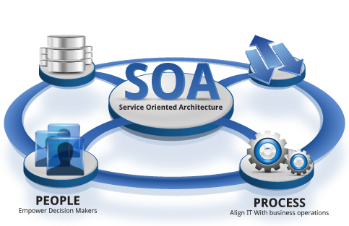

Data Deployment
Plan
Execution
Desirable Resource
Allocation
Actual Resource Allocation
All computing services can be managed as named resources
Extra Reading: SoA and the Bezos Mandate
a data serialization
standard for all computing services
Notes:
Open Sourced Tools like Kubernetes, continuously compares Actual Resource Allocation/Availability against the Desired Resource Allocation Specification

Slide 26
Universal Data Abstraction
Data Platform Strategy is all about
a Unifying Data Abstraction
An abstraction that applies across all spacetime locations and scales

Slide 27
Key-Value Data Type is a Universal Abstraction
Mapped Domains | key/value | Examples
data/data | Inputs/Outputs | Dictionary/Tabulated Data
structure/structure | algorithm/source code | Logical Structures/Functions in Software Libraries
language/language | Specification/Implementation | Source Code/Executable Binary
Notes:
Soundness (Aliveness vs Safety = Correctness)
Precision (The result has a outer boundary)
Termination (It will come to completion)

Slide 28
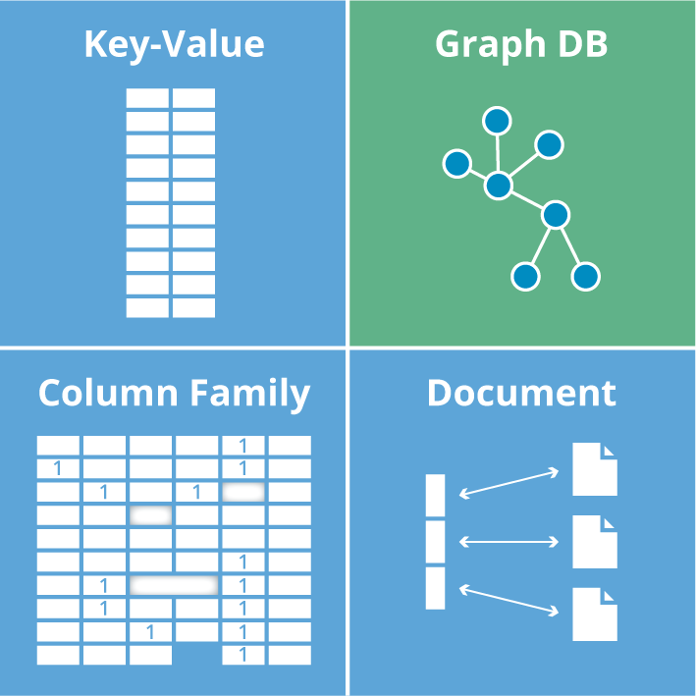
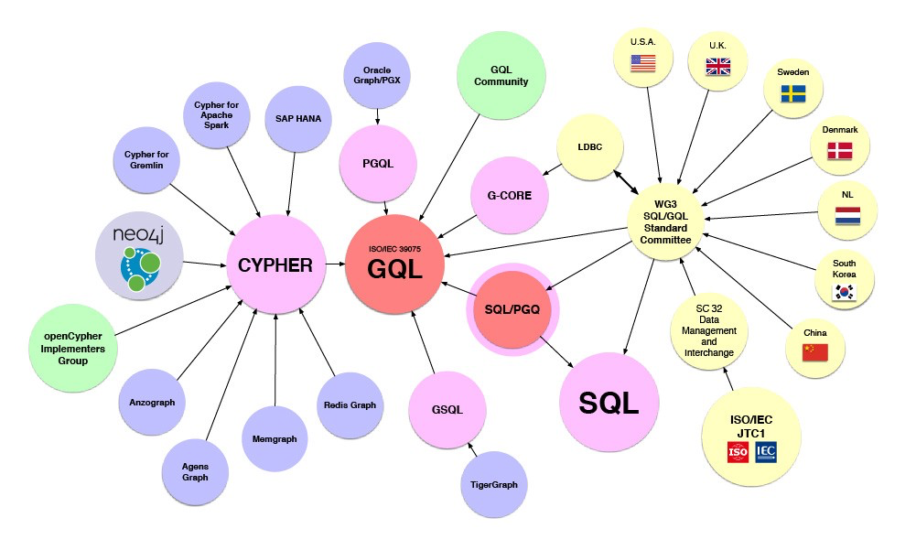







Data Abstractions in the ICT industry
Image source: Graph Database for Beginners by Neo4j

Slide 29
Data Security
ID Management: the accounting practice of Operating Systems
Notes:
(notes)
Make sure that they understand that working with the three challenge projects is to show them that all these principles exist in these organizations. We change the way they view the world so they can solve problems in their own environments
Page services files
Dev Sec Ops
Tools
Work flow

Slide 30



Q&A on menti.com
Use code: 4553 4696
Do you have one or more Open ID accounts?
Do you have Gmail Account or Github Account?
Notes:
Accounts: Keys or Names of the Assets

Slide 31




Two kinds of Accounts
Centralized
Distributed
METAMASK
Ethereum
Notes:
Accounts: Keys or Names of the Assets

Slide 32
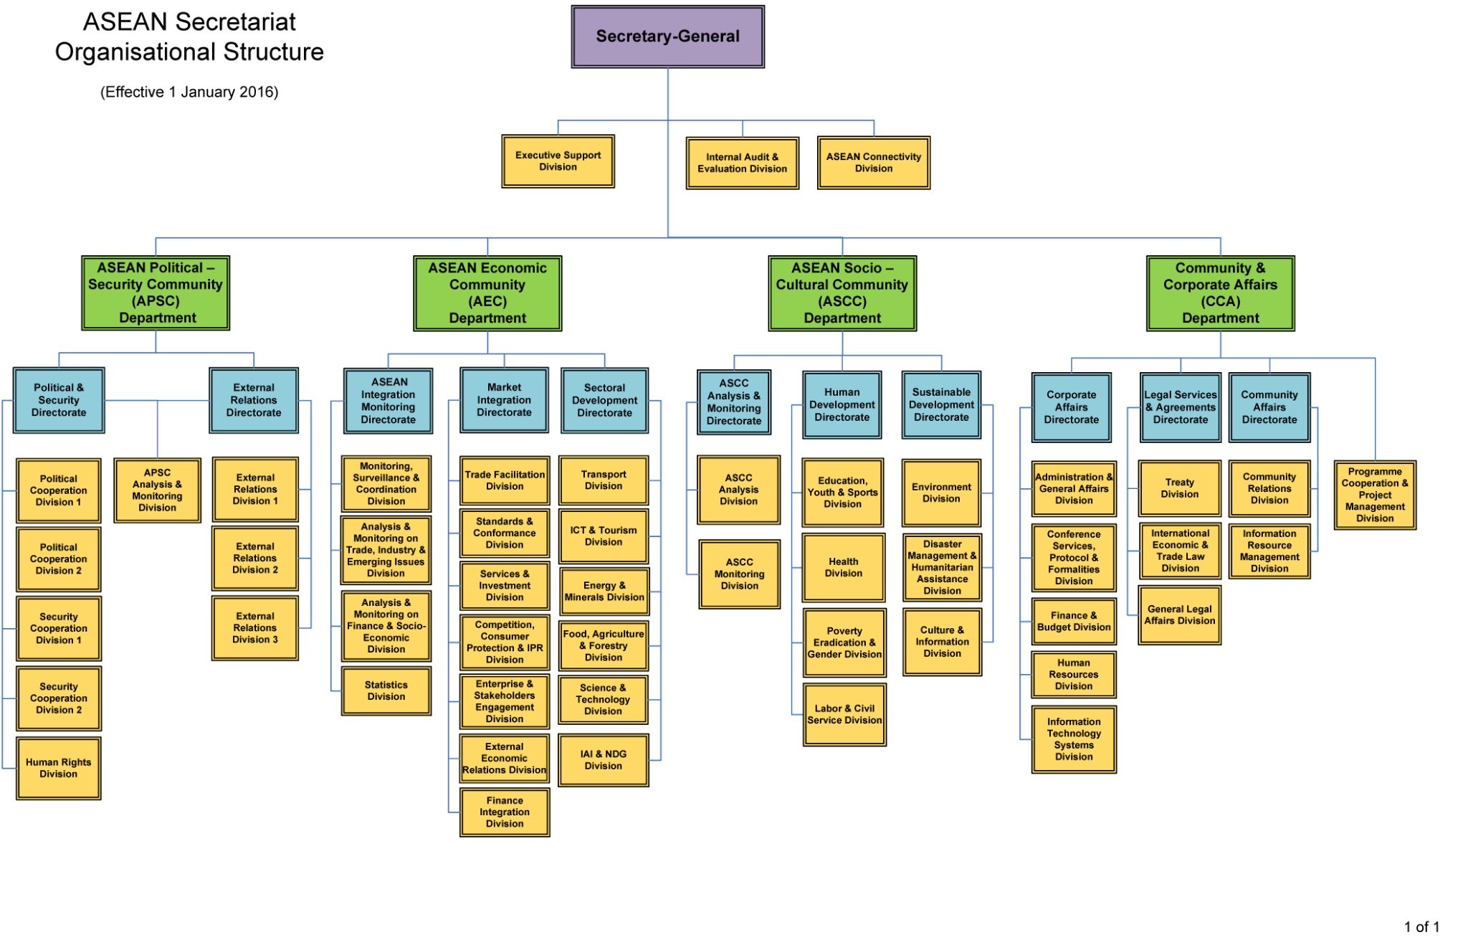
Account Security for Public Agencies

Slide 33
Q&A on Menti
Use code: 4553 4696
OpenID vs. Distributed ID for ASEAN?
and Why?
Notes:
Accounts: Keys or Names of the Assets

Slide 34



Asset Security Domains (Namespaces)
Private
Permissioned
Public
Agreements

Slide 35
How to ensure security under anonymity?

Slide 36

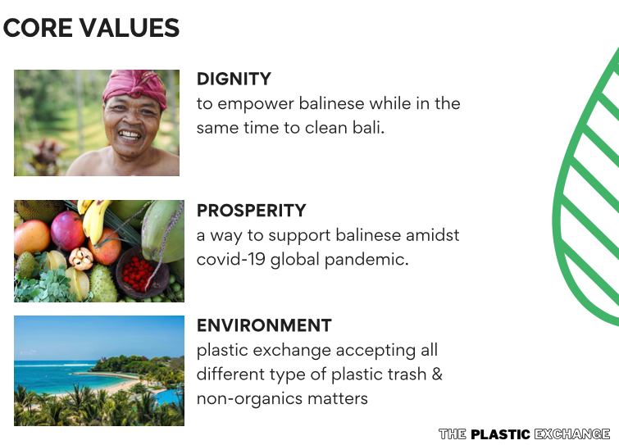
Account Security for Consumer Goods

Slide 37
Q&A on Menti
Use code: 4553 4696
OpenID vs. Distributed ID for Consumer Good Distribution?
and Why?
Notes:
Accounts: Keys or Names of the Assets

Slide 38

Accounting Practice of a Global Transaction Network
Ethereum is an Operating System for Networked Accounts.
External
Programmable
Published Executable Contract
Private Keys
Authorize Participation
Specifies Transaction Details
Notes:
Ethereum organizes all transaction processes in a Unified Format

Slide 39

Accountability through double entry bookkeeping
￼
Accounting
Data Replications
Information Symmetry creates a scalable backbone for distributed systems.
This is now a reality in many distributed systems, including blockchain-based solutions.
Notes:
Accounting: The Process of Value Consensus and Value Admission

Slide 40
Deploying Data
Balanced Design: the defining quality of Operating Systems
Notes:
(notes)
Make sure that they understand that working with the three challenge projects is to show them that all these principles exist in these organizations. We change the way they view the world so they can solve problems in their own environments
Page services files
Dev Sec Ops
Tools
Work flow

Slide 41
Thriving with Data under Moore’s Law?

Slide 42
Exponential growth in ICT is limited by three factors
CAP Theorem: In many cases, tradeoffs between algorithm, data, and computing powers must compromise one of three factors.
Algorithms
Algorithms for big data that provide unprecedented insights and ability to “fake”
Data
Computing Power
Quantitative explosion of devices that produce data, and their connections to networks
Cheaper Computing and Storage Devices
Image source: Dr. Ken Lazarus’s talk on Machine Learning
Notes:
How Startups from silicon valley disrupted the F500 with exponential growth
WHY did they succeed: Because they rely on a new paradigm which is moores law

Slide 43
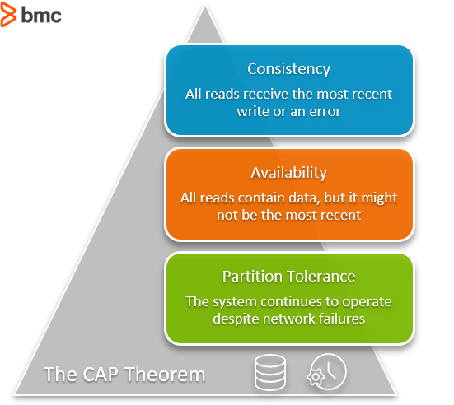
Balancing the CAP Limitations
Consistency
All reads receives the most recent write or an error
Algorithms
that Correctly Synchronizes Data Content
Soundness
Availability
All reads contain data, but it might not be the most recent
Data
that are legitimate to collect and fit everywhere
Precision
Partition Tolerance
The system continues to operate despite network failures
Once Moore’s Law is taken into consideration,
the limitation should be shifted exponentially, too.
Compute Power
to be cheaply replicated for fault tolerance
Termination
Image Source: https://www.bmc.com/blogs/cap-theorem/

Slide 44
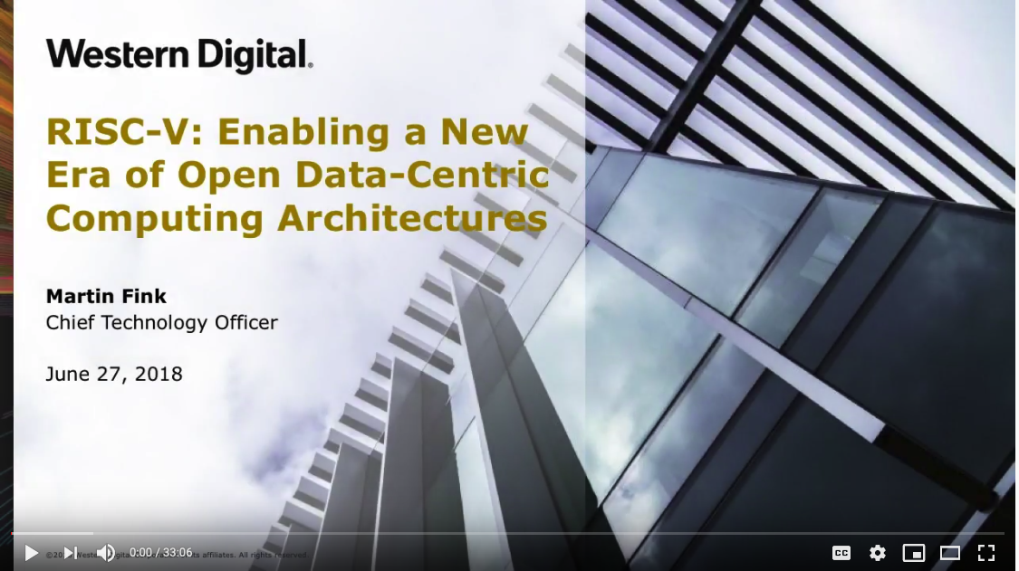

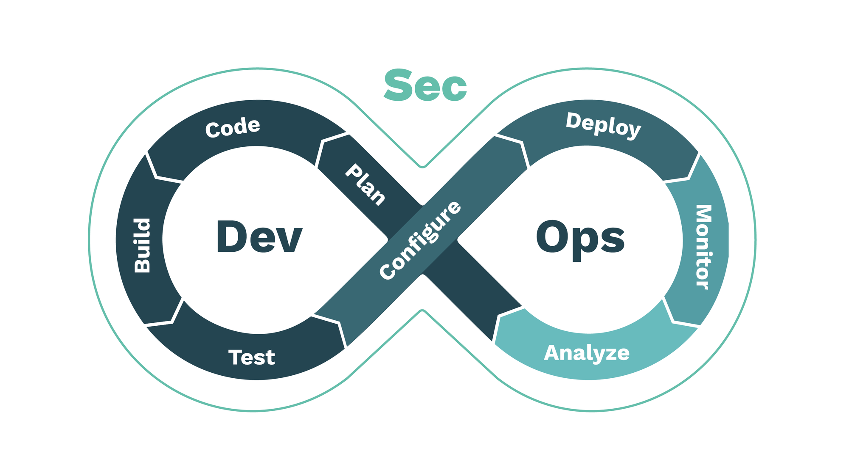
An Automated Solution that spans Three Domains
A Data-Centric
Operating System
Data
that are legitimate to collect and fit everywhere
Page
Service
Validate
Browsers
Algorithms
that Correctly Synchronizes Data Content
Compute Power
to be cheaply replicated for fault tolerance
Develop
Deploy
File

Slide 45



Types of Data Assets
File
Page
Service
Institutionalized Data Assets (Namespaces)

Slide 46

Digital Domains = Accountable Namespaces
Account
File
Page
Service

Slide 47
How to Soundly organize data that relates to
all events in Spacetime?
Future
Present Moment
Time Horizon
Time Horizon
Image Source: Wikipedia on light cone
Past
Public Space
Private Space
Public
Space
Space of Accounts

Slide 48
How to Precisely encode your Data Governance Roadmap?
Service
Deployment
These industrial strength tools are already using key-value pairs to compose Page/File/Service in a human readable format (YAML).
This style of programming is a.k.a. Declarative/Functional Programming.
Page
One way to further streamline the human-machine interaction is to embed all these content into a Page-based Formats, tailored to personal needs.
Henceforth, anyone may use MediaWiki as a Personal Knowledge Container.
Processing
Files
Public
Private
Public
Spaces of Accounts

Slide 49
Will automated procedures Terminate in time?
Service
Deployment
Design Challenge:
A Data-Centric Operating System that allows ethically-concerned human-machine interactions to authorize asset allocation.
Available Resources:
The logos shown in the center of this diagram represent existing building blocks that could be used to construct a Data-Centric Operating System.
Security
Page
Processing
Files
The Operating System in the Era of Big Data

Slide 50
Thread 5 Roadmap in the form of a Glossary
Automation: an machine executable form of Governance
Data: an asset to be evaluated by computing procedures
Governance: making participants and resource accountable
Key-value pair: a data structure that encodes causal relations
Moore’s Law: assign physical dimensions to data with log scale
Strategy: a behavioral approximation of sound rules (law)
UDA: Universal Data Abstraction
Notes:
In the process of data model/information approximation, UDA maybe judged by three conditions: Soundness, Termination, and “Relative” Precision.
All three properties can be teased out of manipulating Lattices/Partially Ordered Sets (POs), which are constructed out of key-value pairs.

Slide 51
Memorize the zero-level Vocabulary
Soundness
Precision
Termination
This is the set of words that represents the quality of other words.
Notes:
(notes) add hyperlinks with definitions
Soundness: A Sound statement is a true statement whose composed sub-statements all accountably true, and the overall constructed statement also can be assessed to be true.
The degree of a statement to be sound is its Soundness assessment.
Precision (The result has a outer boundary)
Termination (It will come to completion)

Slide 52

Summary
Key-Value Pair (hyperlink) is a foundational data structure
Synonyms of Key-Value Pair: Function, Directed Relation, Map, Dictionary
The design patterns of Operating Systems capture the wisdom of Data Governance
Balancing Asset Allocations: Compute Powers, Data, Algorithms
A Roadmap for Data Governance in a spacetime-bound key-value pairs
Time-bound keys | Data Content Space (valuable assets) | Industrialized Tools
Past | Version-Controlled Files and Code | Git and Docker (data and source code)
Present | Dynamically Rendered Pages | Wiki (hyperlinked resources)
Future | Continuously Integrated, Delivered, and Deployed Services | Kubernetes/Nomad (service governance)

Slide 53
The Biggest Secret in the world,
is that there is No Secret!
Given access to cutting-edge Key-Value Instrumentation, you will become aware of the following fact:

Slide 54
References
Data Scott, Outline of a Mathematical Theory of Computation, Jan, 1977
Cousot & Cousot, Abstract Interpretation: A unified lattice model for static analysis of programs by construction or approximation of fixed points, Jan., 1977
Matt O’Dowd, The Geometry of Causality, PBS Space Time, last access: May 27, 2021, https://youtu.be/1YFrISfN7jo

Slide 55
Backlog Slides
Do include Slides

Slide 56
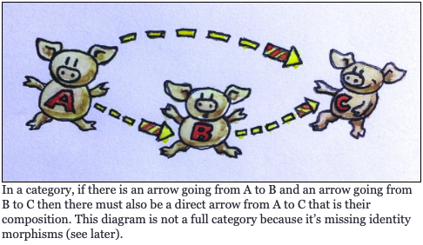
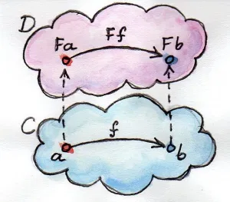
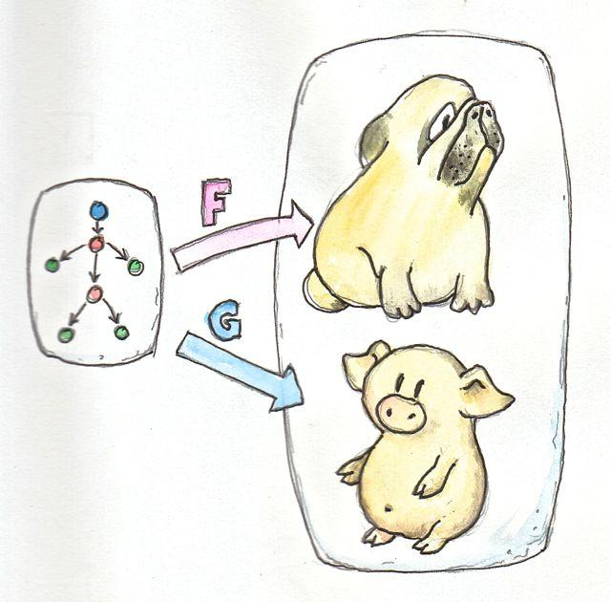
Category Theory: Arrows as Universal Abstraction
Type 0 - Function (f,g,h)
is the relationship between two objects
Type 2 - Functor (F)
is the relationship between two structures (categories).
Type 2 - Natural Transformation
Is the relationship between two functors (F, G).
h
f
g
Source of the three Images: Bartosz Milewski’s Programming Cafe
Notes:
Layer 1: Speak to Comparing Numbers and Names e.g. MAC Address, IP, DNS
Layer 2: Speak to Comparing accounts: Procedures like public private key generation (BIP0032)
Accountable Measuring Relations / Accounting relationship, measuring the relationship between objects NOT the value of objects
Layer 3: Speak to comparing encryption standards: Less precision / More precision;

Slide 57
Hierarchical Deterministic Wallets - Accounting with Keys
Master Keys /
Parent Keys
BIP0032 + Stebila (Improvement)
Private Key
Public Key
Notes:
TODO UPDATE SLIDE TO BETTER GRAPHICALLY REPRESENT ITÄS MESSAGE
Private Key = Green
Public Key = Red
Correct Arrows

Slide 58
Causal Cone Diagram
Future
Deployment
Present
Time Horizon
Secured Decisions
Past
Processing
Public
Private
Public
Spaces of Accounts

Slide 59
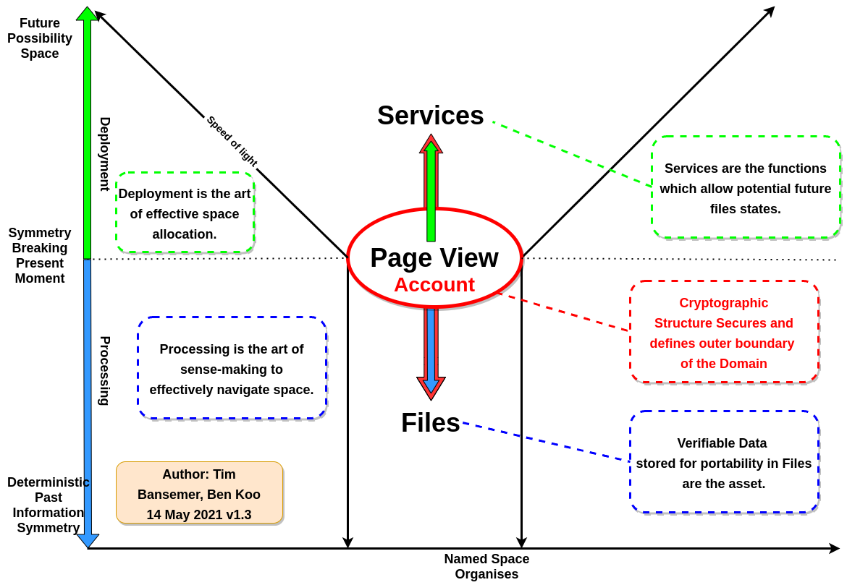

Causal cone in Spacetime
VERIFIABLE HISTORY
Notes:
Universal Abstraction: Page - Service / File; Data Symmetry and Symmetry Breaking; 4 Fields of Data Governance: Data Organisation, Data Processing, Data Deployment, Data Security
Version of page history
File transfers, github,
Service transfers docker-hub

Slide 60
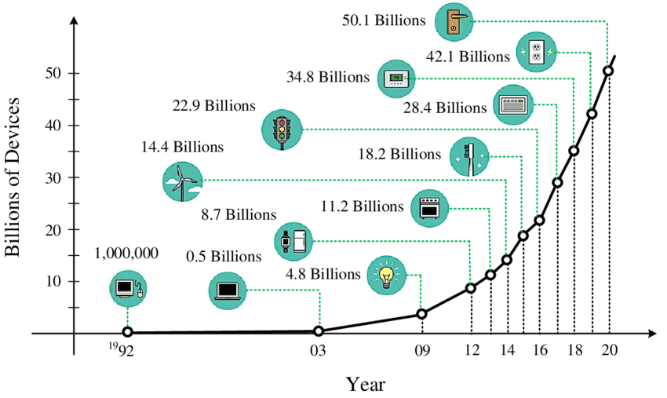
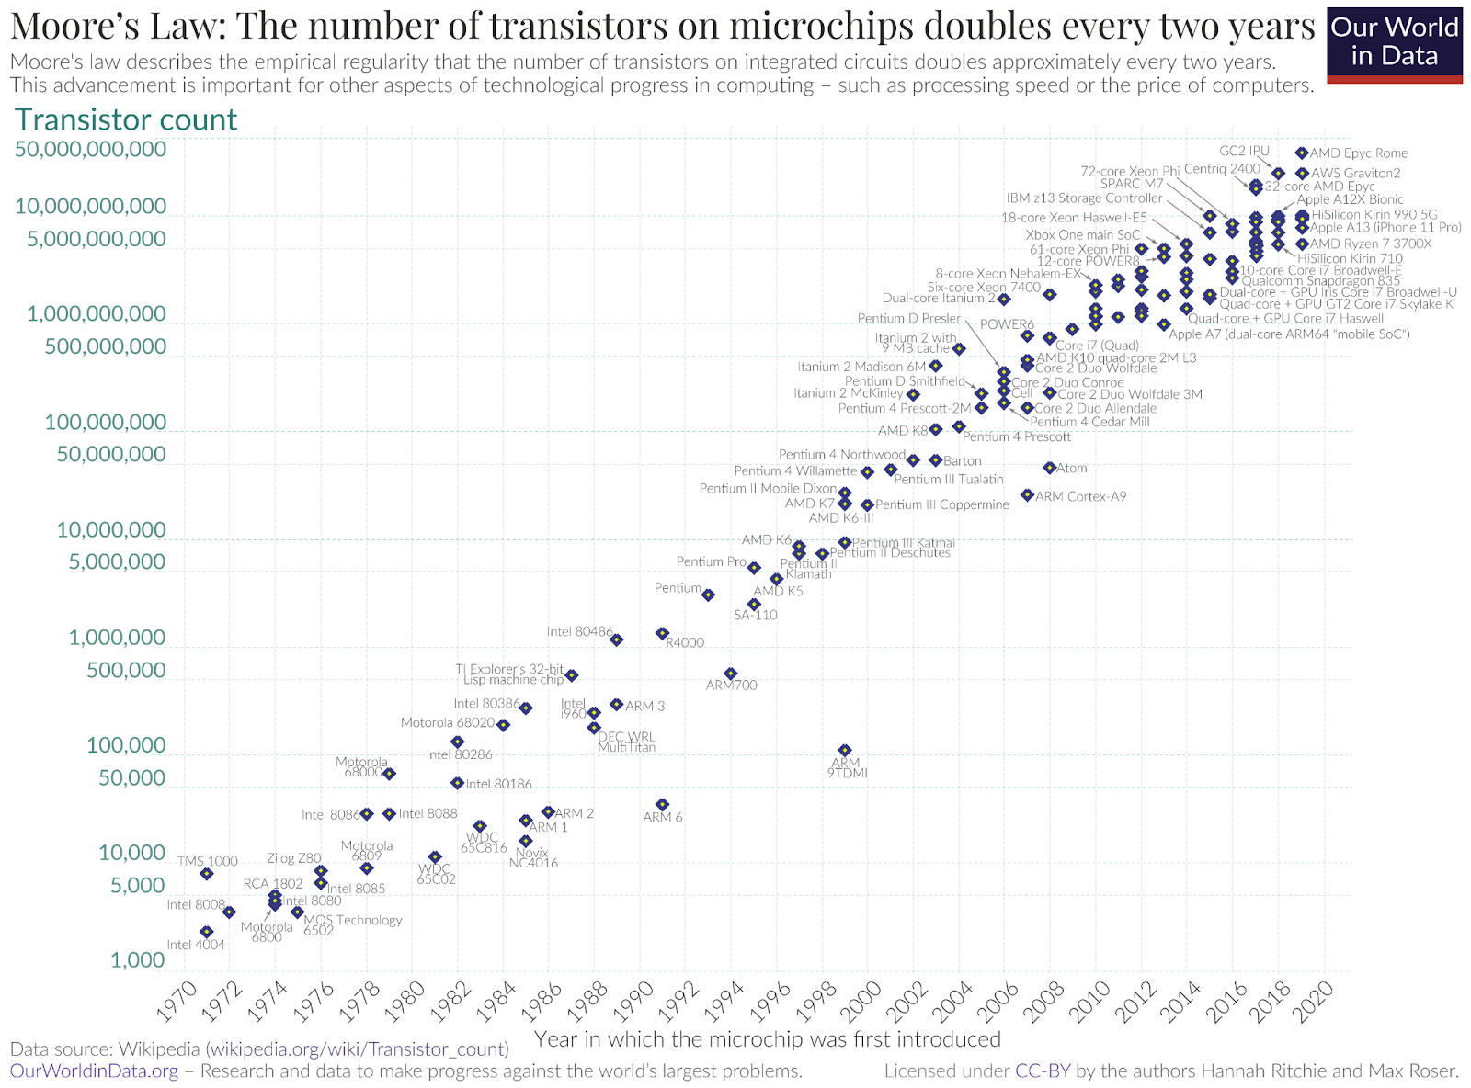
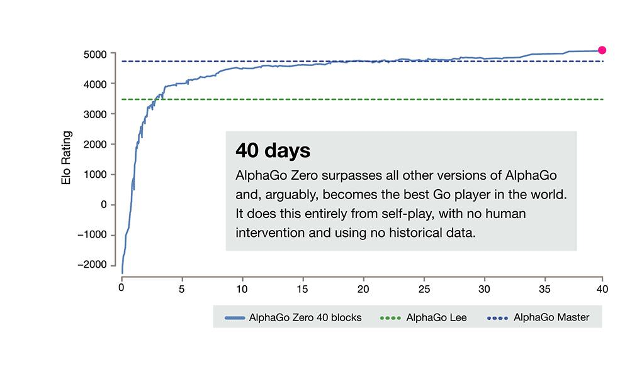
Balancing Dynamics
Access to Data
Signalling
Computing Resources
Processing
Effective Algorithms
Sense-Making
Notes:
Governance must a balance between three things: (the 3 circle diagram)
Computing Resources (Instrumentation) : governed by Moore’s Law
Data Availability (Sensor Deployment) : governed by Social Contracts
Knowledge on Algorithms (Software refinement) : governed by Source Code

Slide 61
Innovation and Adoption speed as driving forces
Explain in relationship to signal / sensemaking / decision / reflection
Relate this back to Continuous Development and Integration and Secure Development and Operation processes. - the ability to continuously operate services to operate services while upgrading them.

Slide 62
Data Governance
Complex-Adaptive-Systems | Perception | Sense-Making | Agency | Reflection
Data-Governance as Cybernetic Systems | Signalling: Human & Sensory input | Data-Processing Proposals / Possible Trajectories | Decision Making (Symmetry Breaking) & Data Deployment | Meta Analysis Recursive Governance Processes
Notes:
https://dro.deakin.edu.au/eserv/DU:30106709/cysbulski-simplifyingsensemaking-2018.pdf
Tools, Workflows, OpenSource & Practices
Universal & Unifying Abstraction: Like Flatter https://en.wikipedia.org/wiki/Flutter_(software)

Slide 63
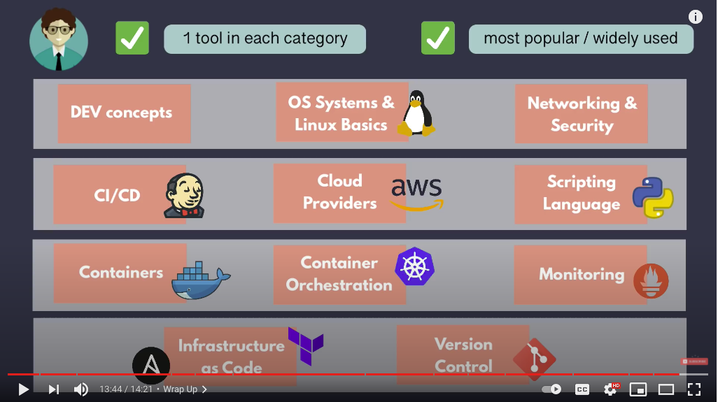
A Technology Road Map
Image courtesy: DevOps Roadmap 2021, TechWorld with Nana
Notes:
https://dro.deakin.edu.au/eserv/DU:30106709/cysbulski-simplifyingsensemaking-2018.pdf
Tools, Workflows, OpenSource & Practices
Universal & Unifying Abstraction: Like Flatter https://en.wikipedia.org/wiki/Flutter_(software)

Slide 64
Organizing Data to keep Values Accountable
Many Profound Data Governance Projects are created by one person or small team
These people holds the key to the unreasonably large amount of information, which is subsumed in a singular model:
Universal Data Abstraction
Notes:
In the process of data model/information approximation, UDA maybe judged by three conditions: Soundness, Termination, and “Relative” Precision.
All three properties can be teased out of manipulating Lattices/Partially Ordered Sets (POs), which are constructed out of key-value pairs.

Slide 65
Take Home Messages
Awareness and Competency in Data governance
Account as the Namespace (key-value pairs)
Aware of ICT terminology (namespace) is a starting point (documented on xlp.pub)
Trends in Web-based Digital Publishing Workflow
Unifying Data Abstraction in terms of Page/File/Services
Wiki: Pages as the Universal Human-Machine interfaces for ICT Resources
Git: Files as Universal Containers of Time-stamped Data
Docker/Kubernetes: Services as a Software-defined Infrastructure
Governance Capability can be judged by its ability to respond to change
Reaction Clock speed: DevSecOps compresses clock-speeds
DevSecOps + CICD prescribes a Road Map to produce and protect Data Assets
Your HDX Design Challenge must start by making your Data Assets accountable
Accounts -> Accounting -> Accountability
Notes:
In the process of data model/information approximation, UDA maybe judged by three conditions: Soundness, Termination, and “Relative” Precision.
All three properties can be teased out of manipulating Lattices/Partially Ordered Sets (POs), which are constructed out of key-value pairs.

Slide 66
Key-Messages
Logic Model, Symmetry, Symmetry Breaking,
Abstract(ion) Interpretation (Universal Interpreter for Abstract or dynamic Source code), Category Theory, Domain Theory, Dana Scott. Patrick Cousot: Semantic Web (Concrete Domain); Abstraction Layer (Category for ‘Correct Content following Alive vs Safe Domains).
Meaningful set of publishing has everything to do with systems engineering approach for meaning assignment and correctness (lamport: consensus).
Providing a computable architecture to have correctness in data abstraction.
Notion liveness and safety.

Slide 67
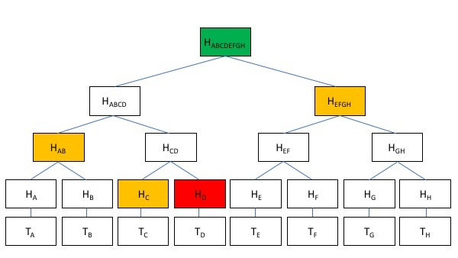
Page
Page
Page
Page
Page
Page
Page
Page

